Slide 1


Remote repositories
Hugh Shanahan
July 2022 CODATA-RDA Data Science School

Slide 2
What are remote repositories?
Effectively ‘Git on a cloud’
Services where you can upload your local repos
You and others can download repos
You can collaborate with others on the same repo e.g.
You upload a repo
Your colleague downloads it
Makes some changes/adds a new file
Uploads the updated repo
These services often have many many more features…

Slide 3




Many such services exist….for example

Slide 4

Github
Very much the most well known of these services
Git/GitHub almost seen as interchangeable
Owned by Microsoft
Subject to USA law
Lots of many nice features
Web page site (Github pages)
Software Carpentry lessons uses this.
GUI for adding files….

Slide 5
Codeberg
Codeberg e.V is a registered non-profit association
Based in Berlin, Germany
One can become a member of the association
But it doesn’t stop you from just getting an account!
More limited functionality to GitHub

Slide 6
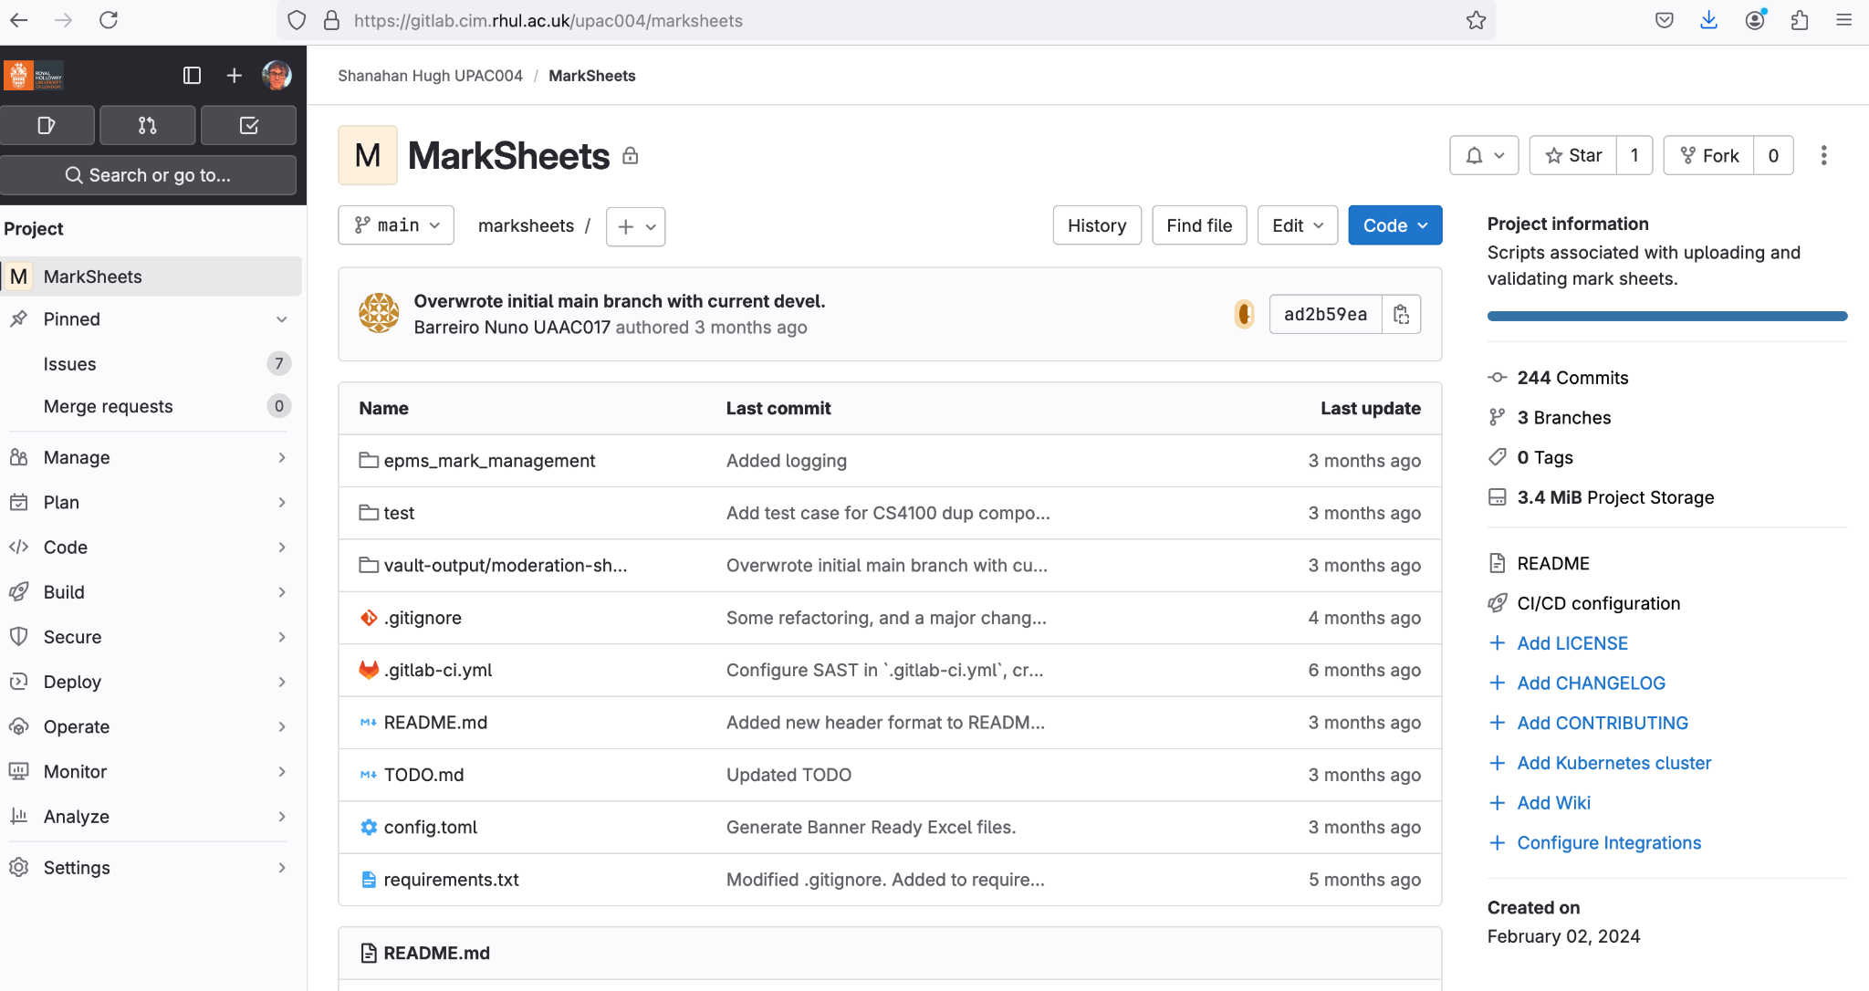
GitLab
Another service like GitHub
But one can also download the software to run the server software locally

Slide 7
We will use Codeberg - why?
GitHub is great but
Being subject to US law it has blocked access to particular countries in the past.
The repositories are harvested for LLMs.
It’s good to know of alternatives in any case.

